Slide 1




Satellite-Based Lake Eutrophication Mapping
TEAM NAME: Binary Brains

Slide 2


PROBLEM STATEMENT
One of the serious environmental issues that affect ecosystems, biodiversity, and the health of the population is water pollution. Water sources are becoming increasingly polluted due to industrial effluent, agricultural runoff, and the pace of urbanization. Large-scale, long-term water quality measurement is required for sustainable water resource management. However, manual sampling and laboratory analysis, which are costly and time-consuming, form the basis of conventional methods. Moreover, the temporal and spatial scales of these methods are limited. Therefore, there is a large gap in the sustainable measurement of water pollution.

Slide 3


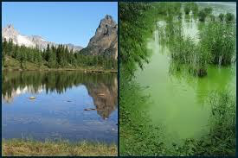

Our Solution
We developed a satellite water pollution detection system that enables comprehensive and continuous testing to move past the limitations of traditional water quality testing. Critical water quality parameters such as turbidity, chlorophyll concentration, and organic material estimates are calculated by the system using Sentinel-2 multispectral band data. To improve the model’s ability to distinguish between pure and polluted water bodies, complex spectral features and engineered features are created. These features are used to train a machine learning classification model that predicts the probability of pollution.
The solution is implemented using a Flask API, providing users with the capability to input spectral band values and receive real-time pollution predictions. This approach fosters sustainable water resource management while ensuring scalability, viability, and automation.

Slide 4


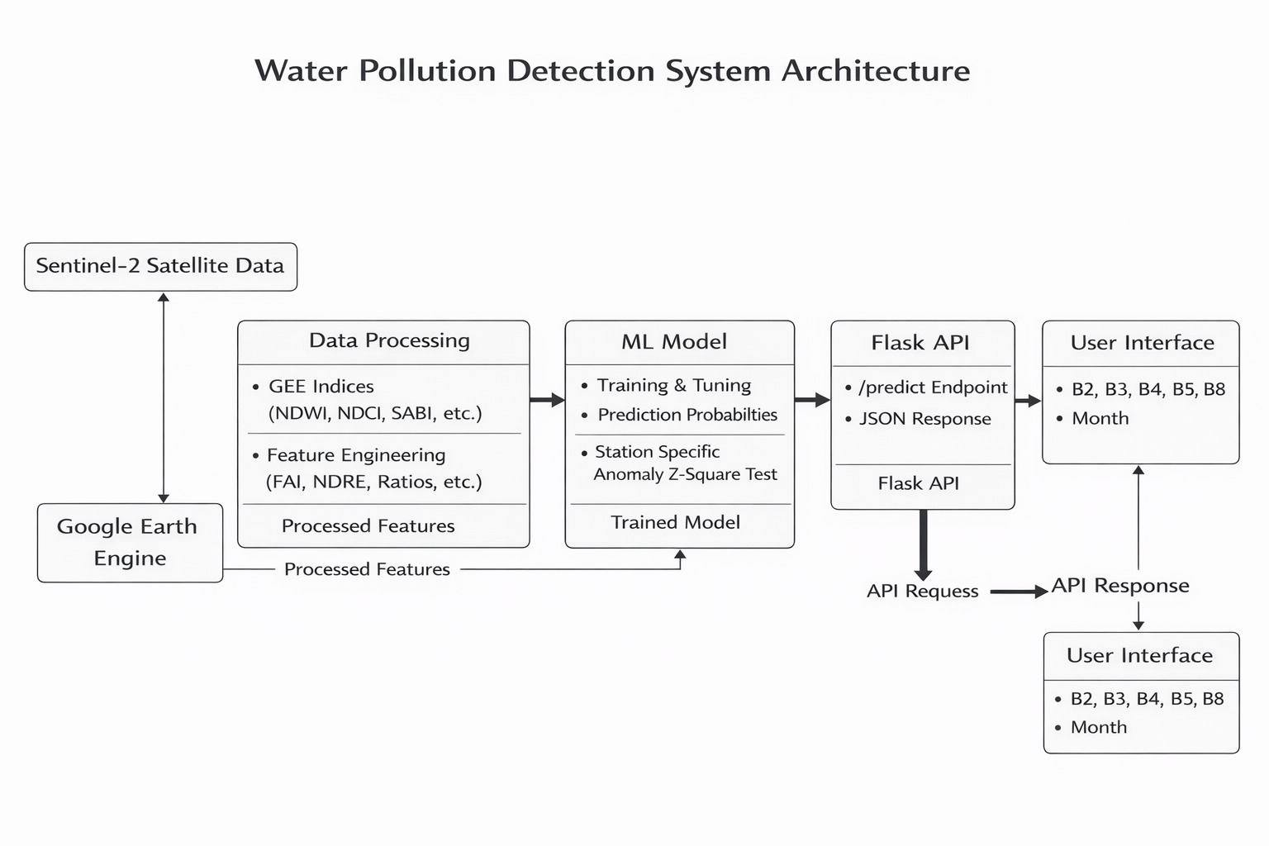

ARCHITECTURE

Slide 5
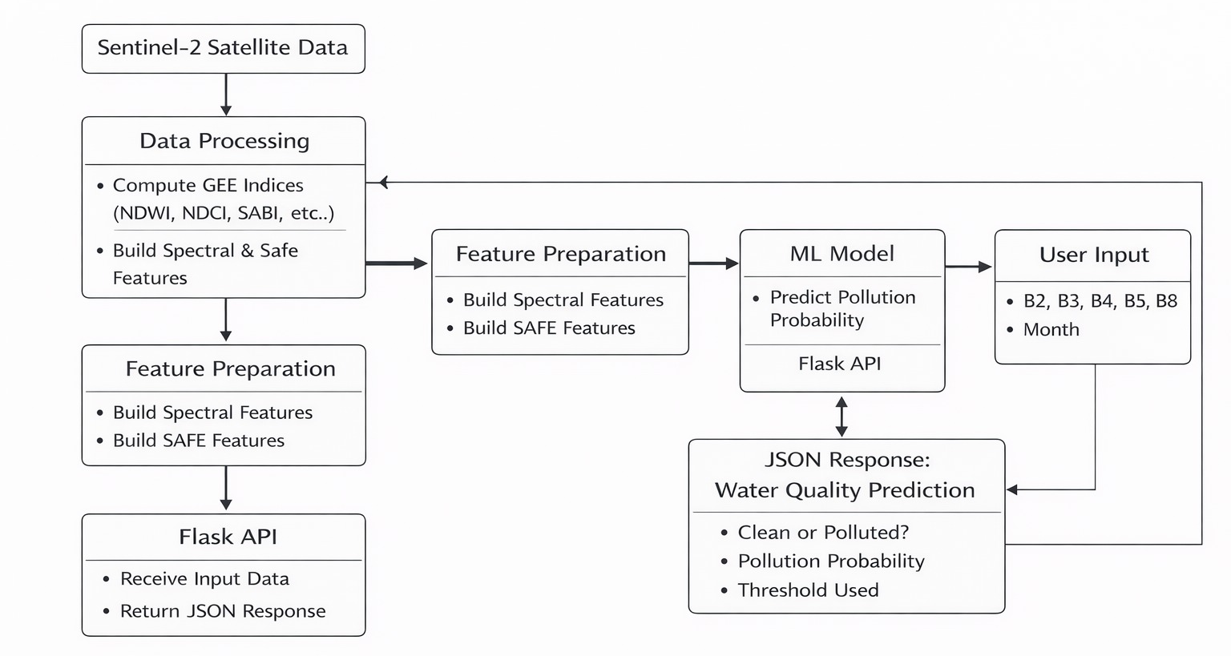
Work Flow

Slide 6
Step 1: Satellite Data Acquisition
Sentinel-2 multispectral band data (B2, B3, B4, B5, B8) is collected using Google Earth Engine. Temporal information (Month) is also included to capture seasonal variations in water quality.
Step 2: Feature Engineering & Index Computation
Raw spectral bands are transformed into meaningful water quality indicators.
This includes:
Water indices (NDWI, NDCI, SABI)
Turbidity and band ratios
Advanced spectral features (FAI, NDRE, WDRVI, NDRB)
Organic matter proxies (CDOM, BOD proxy)
Seasonal encoding (sin_month, cos_month)
Interaction and polynomial features
These engineered features help the model better distinguish polluted and clean water.

Slide 7
Step 3: Model Training (Offline Phase)
The processed features are used to train a Machine Learning classification model.
Feature selection is finalized
Model is trained and tuned
Pollution probability prediction is enabled
Final trained model is saved as water_pollution_model.pkl
Step 4: API-Based Prediction System
The trained model is deployed using a Flask API.
When a user sends band values and month to the /predict endpoint:
Input is validated
Features are generated dynamically
Data is arranged in the exact training order

Slide 8
Step 5: Pollution Probability & Decision
The model calculates pollution probability using predict_proba().
If probability ≥ 0.49 → Water is classified as Polluted
If probability < 0.49 → Water is classified as Clean
The API returns:
Pollution label
Probability value
Threshold used

Slide 9
Conclusion
Through eutrophication, the water bodies are silently degrading and sometimes it may be detected when the process has taken place and the result is catastrophic. The present project has shown that the constant and extensive monitoring of lake health can be achieved through the free access of Sentinel-2 satellite data along with the preexisting indices like NDWI, NDCI, and Trophic State Index.
The system will enable a scalable, cost-effective, spatially exhaustive system of determining the level of eutrophication by removing reliance on field sampling, which is time-intensive. It allows catching and visualizing these early and making informed decisions to support communities, farmers, and policymakers that depend on the presence of freshwater.
Although issues such as cloud cover and environmental variability still exist, the work itself is a considerable step of proactive and technological-based environmental monitoring, which adds to the problem of sustainable management of freshwater ecosystems.

Slide 10
TEAM MEMBERS
Ponjeyakumar R -22MIS1035
Joshika B R -22MIS1147
Hema swethaa V T - 22MIS1133
Samaseni Bindusri - 22MIS1061
Loukhya Y - 22MIS1041

Slide 11
Thank You!
!uoY knahT

